Slide 1
SMART AI WEED DETECTION WITH REAL-TIME OBSTACLE DETECTION

Slide 2
ABSTRACT
This presentation explores how IoT, and machine learning revolutionize crop farming with advanced weed monitoring. Emphasizing precise weed detection, our solution integrates IoT with Machine learning to enhance efficiency and address environmental concerns. The project aims to reduce human efforts, optimize tasks, and promote sustainable, health-conscious farming practices, contributing to agricultural advancement.

Slide 3
INTRODUCTION
Brief Introduction to Project:
Agriculture is vital for our sustenance, and effective weed management plays a crucial role in maximizing crop yield.
Introducing an innovative solution - Smart AI Weed Detection with Real-Time Obstacle Detection.
Importance Of Weed Detection
Weeds compete with crops for nutrients and resources, affecting overall crop health and productivity.
The implementation of smart AI offers an effective, sustainable solution for weed management, reducing reliance on traditional herbicides.

Slide 4
Problem Statement
Need For Weed Detection
Timely weed detection allows for intervention to preserve crop vitality and optimize yield.
Uncontrolled weed growth leads to inefficient use of resources like water and fertilizers. Weed detection helps in optimizing resource allocation, reducing costs, and promoting efficient resource use.
Weeds can harbor pests and diseases, posing a risk of contamination to cultivated crops

Slide 5
Goals And Objectives
Adaptation to Varying Field Conditions
IoT Sensor Integration
Real-Time Data Collection
Deep Learning Model Deployment
Accurate Detection Of Weed
Cost-Effective Solution
Data Accessibility

Slide 6
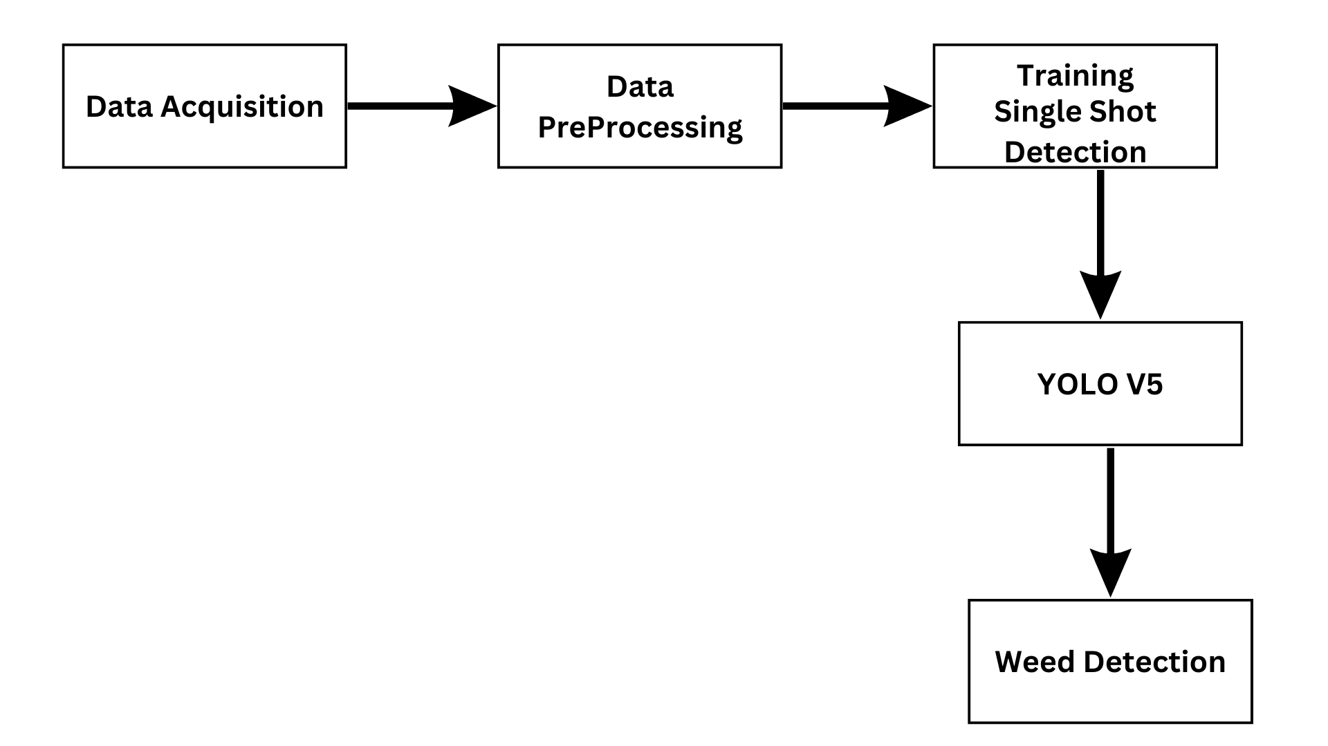
Methodology

Slide 7
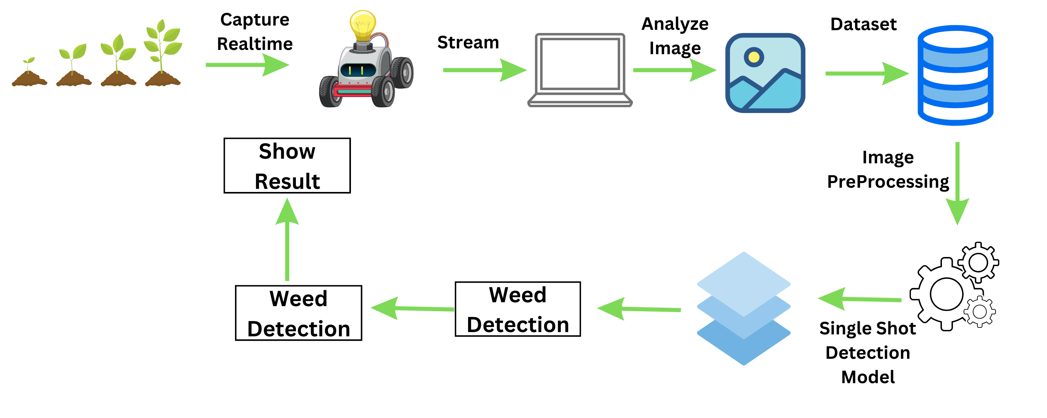
Methodology

Slide 8
Data Collection And Preprocessing
Collection
Pakistani Weed Dataset From Kaggle.
Preprocessing
Image Resizing
Annotation.
Removal Of low-quality images

Slide 9
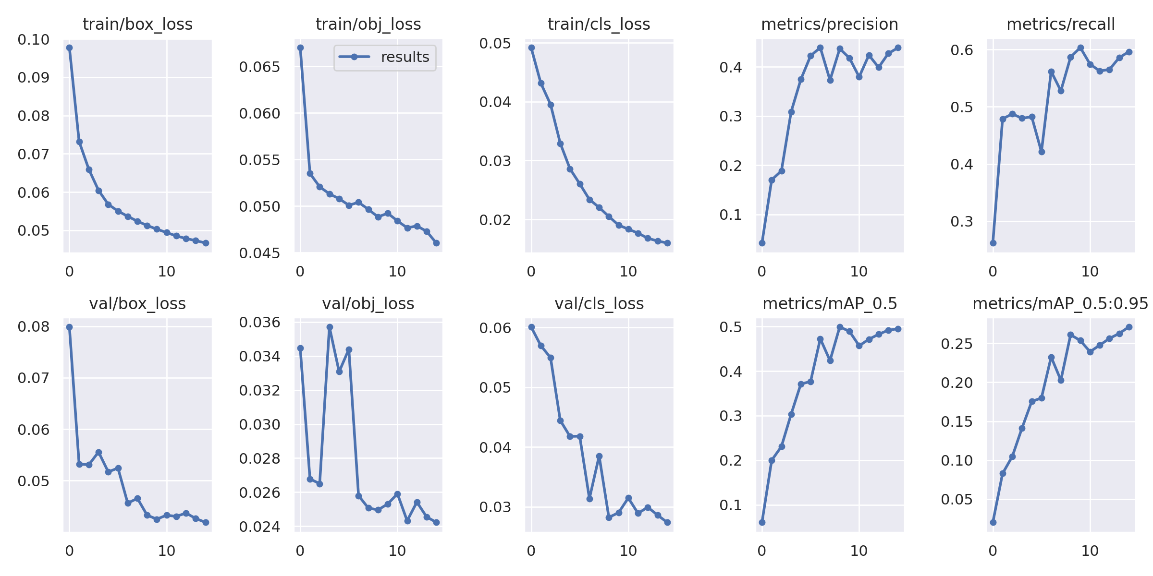
YOLOv5 Results

Slide 10
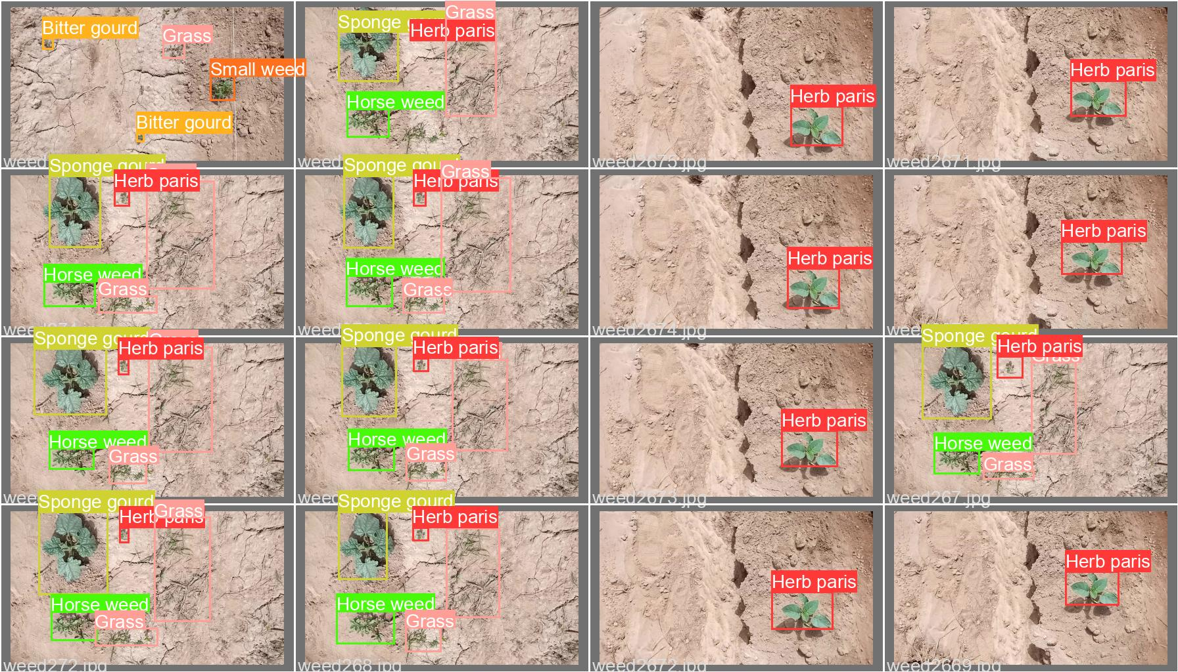
YOLOv5 Predictions

Slide 11
Obstacle Avoidance System
Features
Real-Time Detection
Emergency Stop Feature
Energy Efficient
Sensor Used
Ultrasonic Sensor( Mounted on servo to cover 180 degree)
Micro-Controller Used
Arduino UNO R3 with L293D Moto Driver Shield

Slide 12
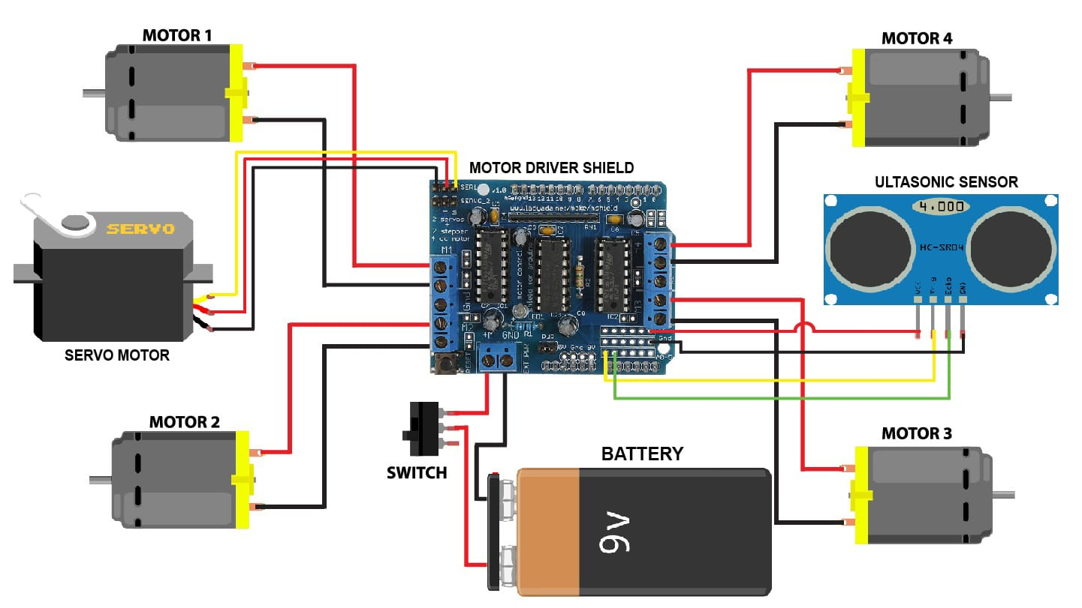
Obstacle Avoidance System - Diagram

Slide 13
User Guide
Instructions
User Manual
Demo Videos

Slide 14
Impacts on Agriculture
Increased Crop Yield
Resource Efficiency
Reduced Environmental Impact
Enhanced Crop Quality
Improved Food Security
Community Empowerment
Economic Sustainability

Slide 15
Questions ??
Queries Are Welcome..

Slide 16
THE END
Thank You

